Slide 1
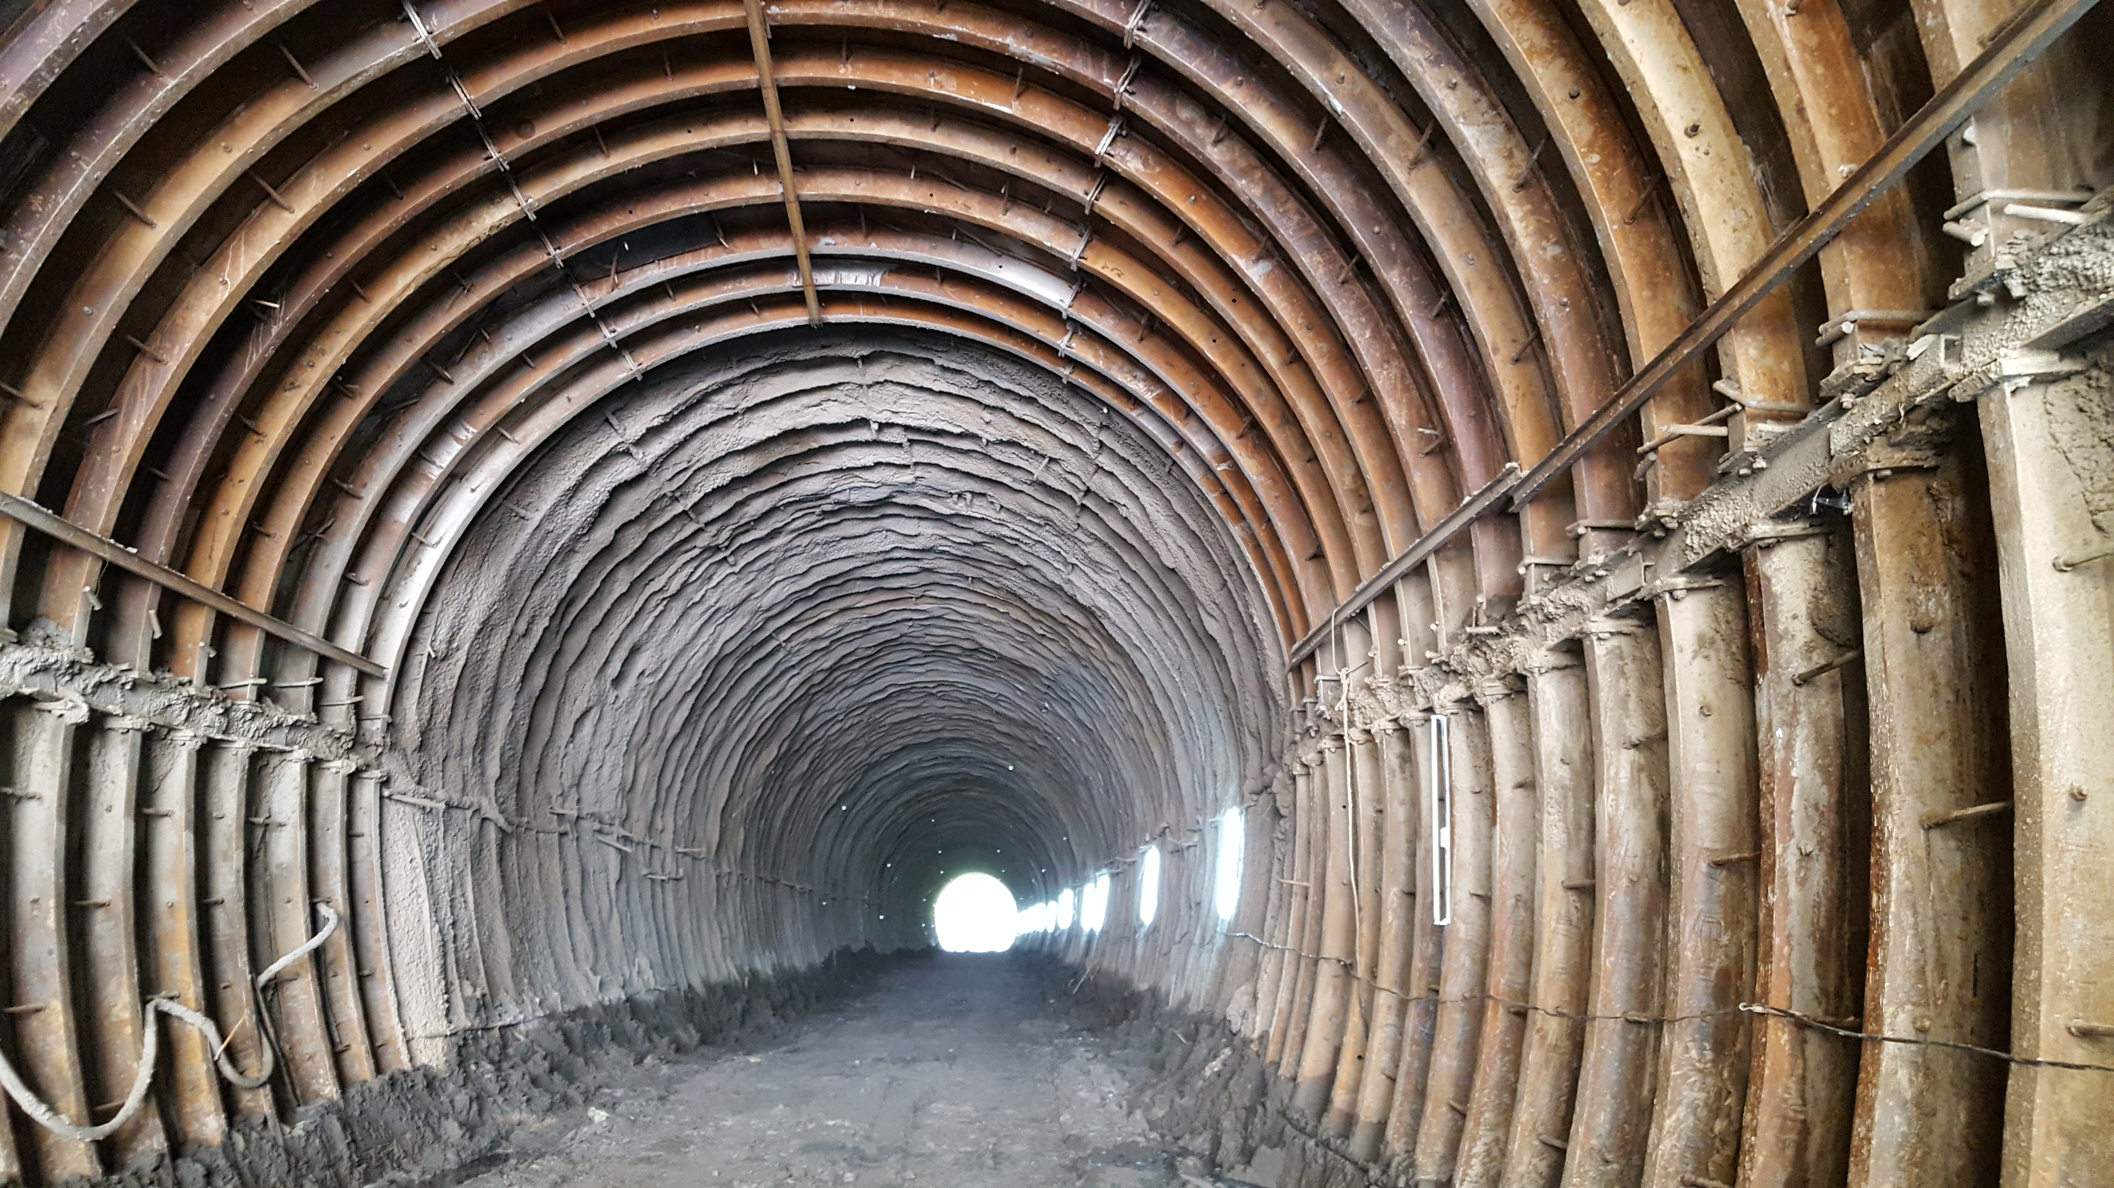
Instrumentation and Monitoring During Construction of Tunnels Bairabi-Sairang NL Project
By-
A. K. Yadav, CAO/C/III/NFR
S. P. Deshmukh, Dy. CE/C/Bairabi/NFR

Slide 2
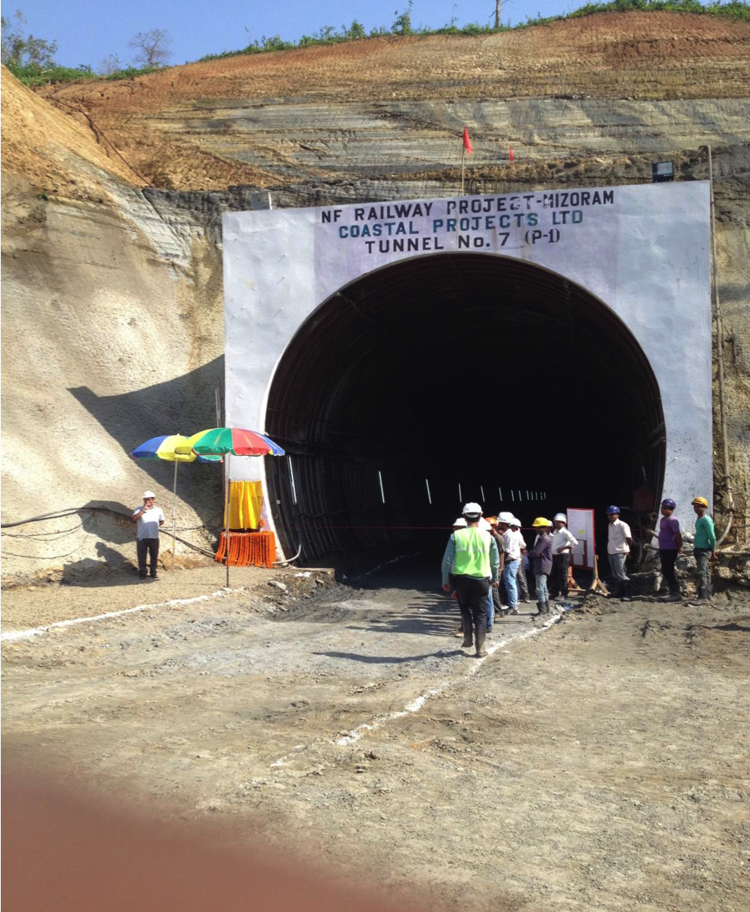
Introduction
N. F. Railway is executing tunneling on large scale with about 170 km tunneling against various sanctioned Gauge conversion, Doubling & New line works in challenging geological conditions in hilly terrain of NE region

Slide 3
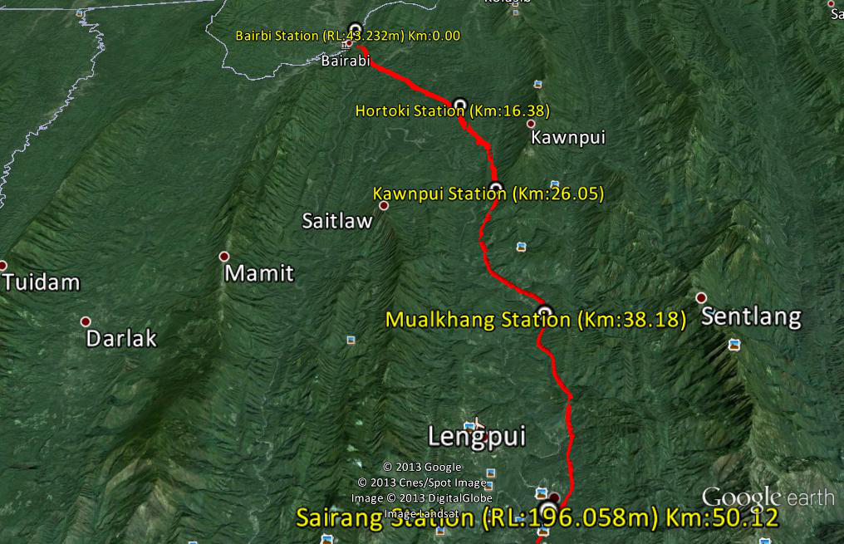
Fig. 1. Plan of New Railway Line from Bairabi to Sairang, Mizoram

Slide 4
Introduction
continued
Topography in the region is largely immature with steep slopes, narrow intervening synclinal valleys and series of parallel hummocks.
The geological strata in this area consists of sedimentary deposits having many folds and faults.
During tunneling, strata observed is mainly soft and yielding, which as per Barton’s Rock Mass classification is categorized as Type IV to Type VIII.
In such weak soil/rock strata tunnels are being constructed using NATM (New Austrian Tunneling Method).

Slide 5
Methods of Tunnelling & Instrumentation
Classical Method - Used up to last half of 19th century ,No instrumentation.
Mechanical Drilling and cutting Minimal use of instrumentation.
Drill and Blast Method
Shield method by TBM - Ground movement monitoring, temperature sensors, vibration sensors (accelerometers), hydraulic pressure sensors, electrical current sensors are used.
New Austrian Tunnelling Method
(NATM) (Design as we go) Dynamic design requires
ADECO RS Method monitoring
NTM (Norwegian Tunnelling Method)

Slide 6
Why instrumentation ?
To accurately quantify structural behaviour and to monitor their rate of change.
Observe movement stabilization, or in the case of acceleration, to deduce the possibility of failure.
Observation of state of stress in rock mass and its response to disturbances by construction and operation of the structure.
The comparison of measured values with design values.
Monitoring of tunnel stability and the possibility of implementing corrective measures at the appropriate moment.
Instrumentation is also used to monitor the in-service performance of the tunnel.

Slide 7
Parameters Measured
Deformations (displacements, strains, changes in inclination etc.)
Stresses
Forces on structural elements (bolt force, normal load on a compression element or steel arch)
Piezometric levels (seepage pressure & pore water pressure)

Slide 8
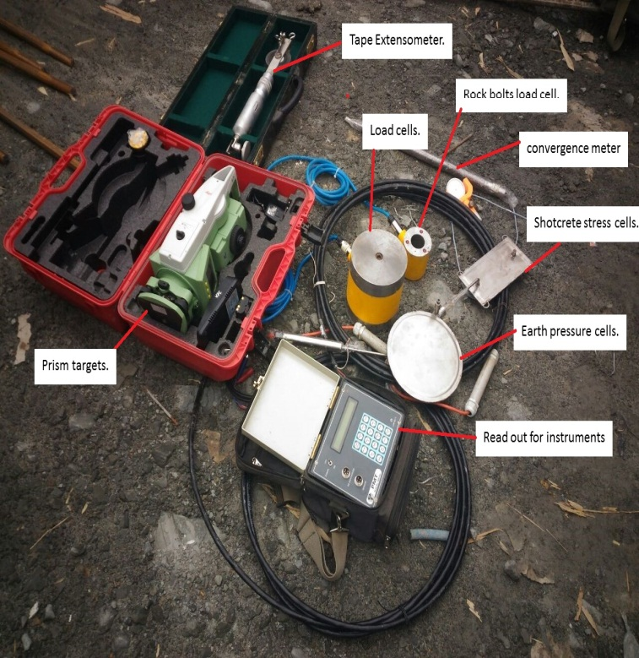
Instruments used in Tunnel monitoring in NATM Tunneling

Slide 11
Instruments and Observation of Parameters
Video
PARAMETER | INSTRUMENTS | OBSERVATION
Convergence | Convergence meter | The contraction or elongation between two fixed points.
Crown settlement | Prism targets. | Changes in x, y & z co-ordinate gives crown settlement. 3D monitoring can be done.
Rock mass settlements | Tape Extensometer. | Two point dimension changes gives rock mass movement.
Load in rock bolts/anchors | Rock bolts load cell. | It gives load on rock bolts to evaluate its accuracy.
Loads in permanent steel structure | Load cells. | Hoop load on steel Ribs is obtained by this method.
Stresses in shotcrete/ concrete | Shotcrete stress cells. | Gives loads on shotcrete.
Earth pressure | Earth pressure cells. | Gives pressure due to rock mass around tunnels.
Strain in ribs and struts | Strain gauge. | Frequency on the tensioned wire gives strain.
Strain in shotcrete | Shotcrete strain meter. | Frequency on the tensioned wire gives strain.
Pore water/ Seepage pressure | Piezometer. | Pore water pressure around tunnel which gives seepage pressure and hydraulic pressure.
END

Slide 12
Case Study Tunnel No-1

Slide 13
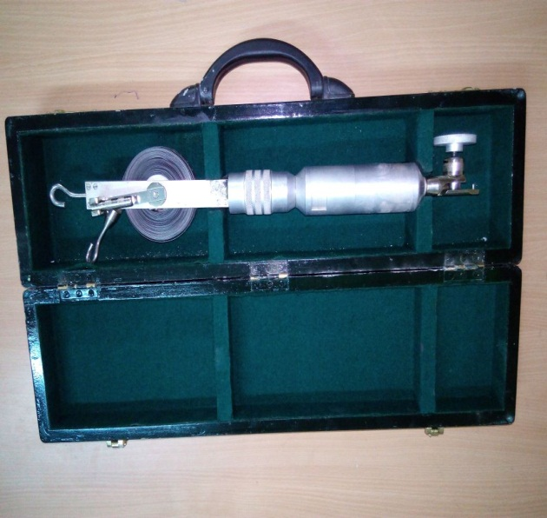
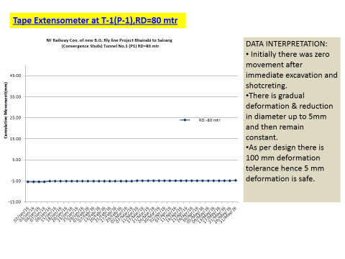
1. Convergence measurement
(i) By tape extensometer
Measure convergence or dimensional change in shape of the excavated tunnel.
Used at 25 m c/c or change of strata in NATM.
It consists of steel survey tape with punched holes loaded on a reel fixed to the body of instrument with a tensioning mechanism having dial/digital indicator.
Its measuring range is upto 30 m and resolution is 0.05 mm.

Slide 14
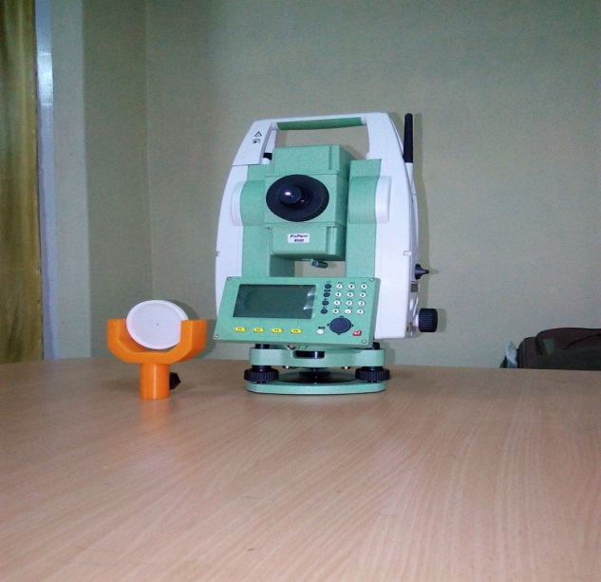
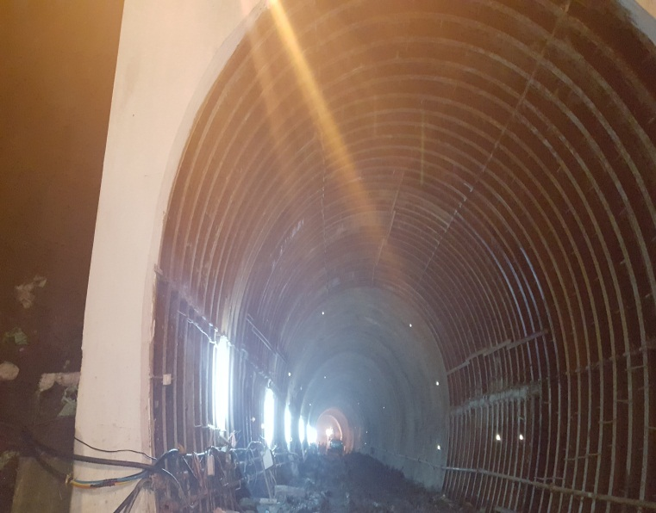
(ii) By Prism Targets:
It is used to measure dimensional change in shape of the excavated tunnel by optical method by measuring its x, y & z co-ordinates.
Reflector targets are fixed along the periphery of excavated tunnel profile.
Periodic readings are obtained which gives relative figures to know dimensional changes in structure.

Slide 15
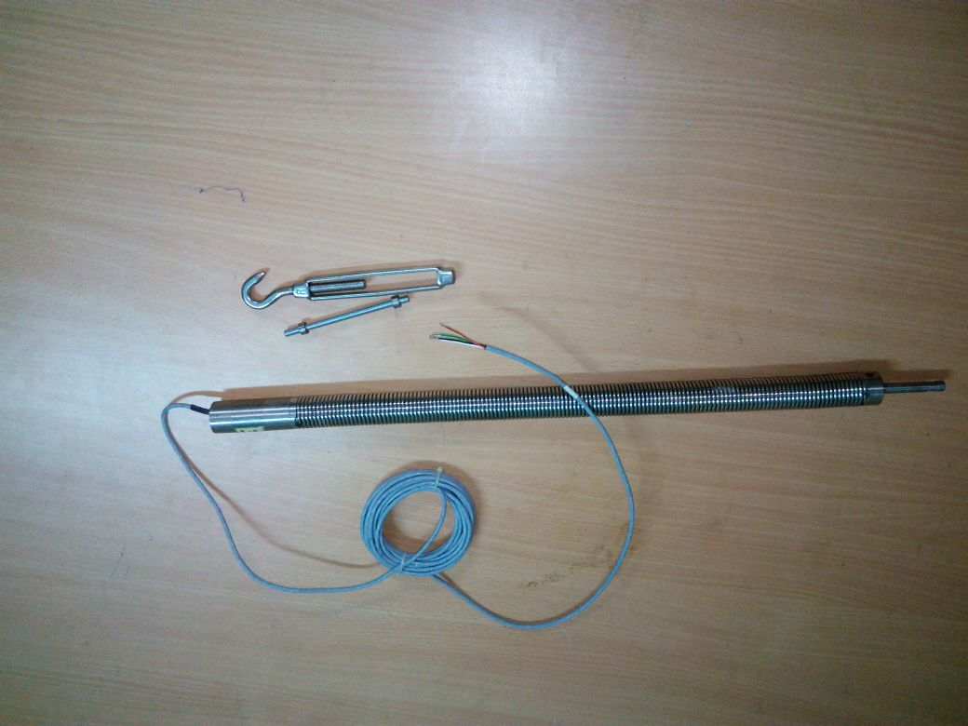
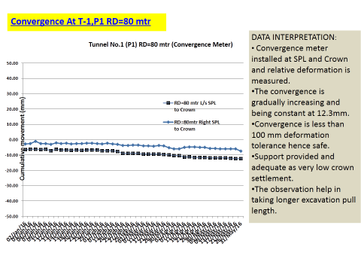
(iii) By convergence meter
Profile is measured by measuring the tension in the extended wire.
It is being used at every 50m c/c or change of strata in NATM.
The vibrating wire convergence meter is designed to detect the deformation of rock or soil masses by measuring the contraction(or elongation) between 2 fixed anchor points.
Anchor points are established in the mass and connecting rods from one anchor leads back to transducer assembly located at the second anchor point. Changes in distance between the 2 anchors are conveyed by the connecting rods and measured by the transducer.

Slide 16
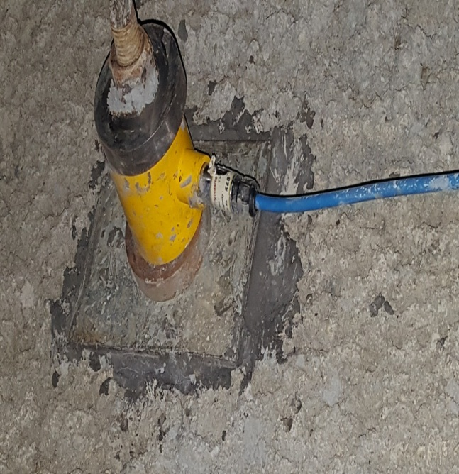
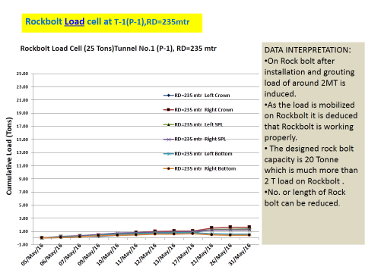
2.Rock bolt Load cell
It measures load in rock bolts & is fixed at 100 m C/C interval or randomly as required.
The vibrating wire load cell are composed of three or six VW gauges mounted parallel to each other equally spaced in a ring cylinder of heat treated steel alloy. When load is applied on the cell, change in tension of the gauge causes change in the frequency that is induced by plucking coil. The average of the reading from the cells represents the mean load on the anchor.
Data is measured in the form of graph showing cumulative load in tons.
Load on rock bolt signify its integrity with the surrounding rock mass

Slide 17
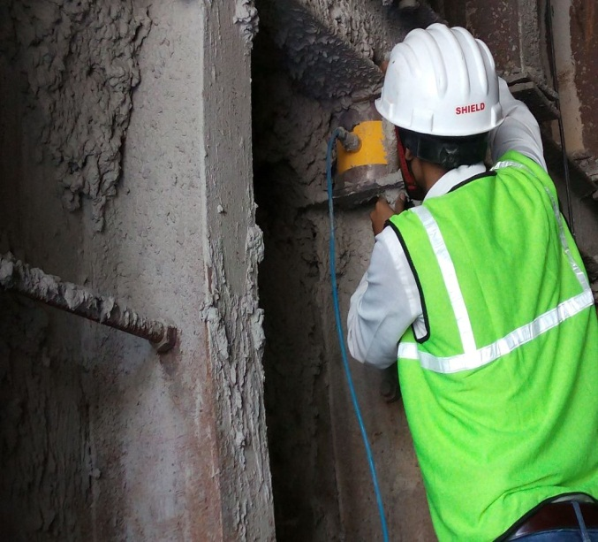
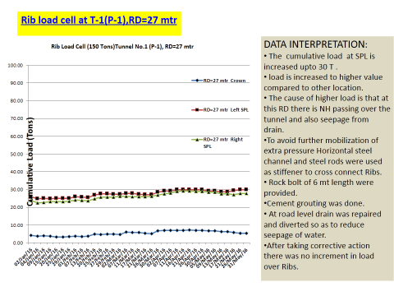
3. Rib Load cell
It measures load in ribs and struts and fixed at an interval of 100 m C/C.
Once the PSS is installed, load coming on it is being measured and analysed for any unusual behaviour.
Data is depicted in the form of a graph showing cumulative load in tons.

Slide 18
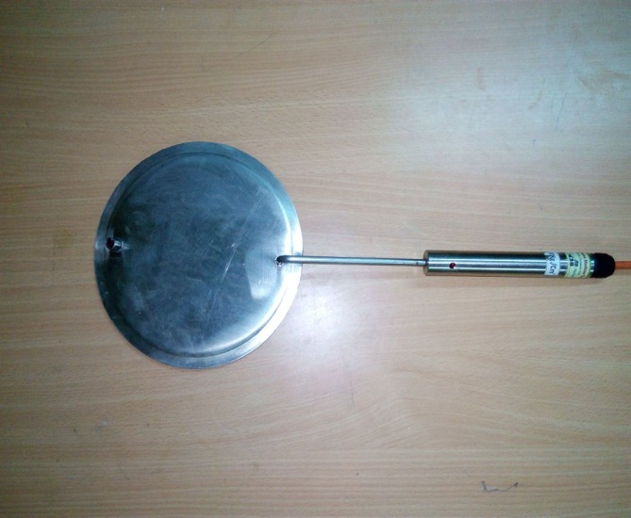
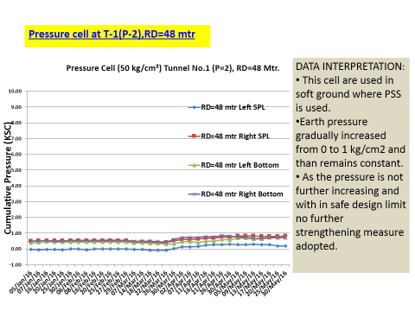
4. Earth pressure cell
It is used to measure the pressure due to Rock mass on support provided for tunnelling.
The VW earth pressure cells consist of two circular stainless steel plates welded together around their periphery and paced apart by a narrow cavity filled with de-aired fluid.
The pressure is converted by the pressure transducer into an frequency signal to the readout unit.
Data is measured in the form of graph showing cumulative load in tons.

Slide 19
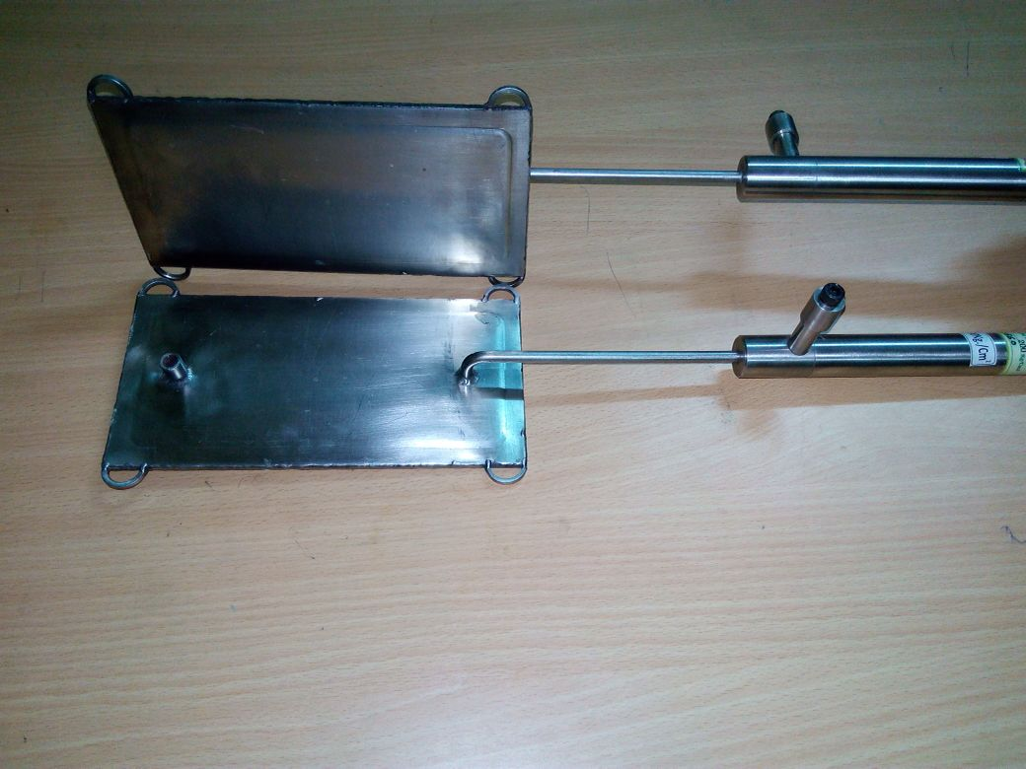
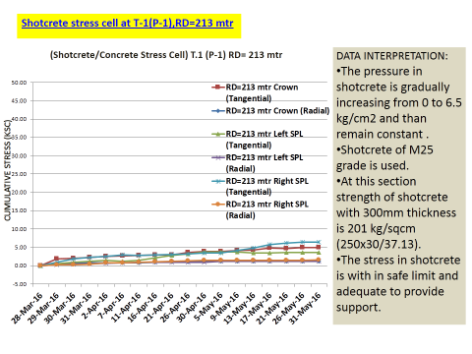
5. Shot Crete stress cell
These have been fixed at an interval of 100 m c/c to measure radial and tangential stresses in shotcrete during NATM.
Fixed between excavated and shotcrete portion and the data is recorded and interpreted accordingly.
It is formed from two rectangular steel plates welded around the periphery. The intervening space between the plates is filled with oil.
A pressure transducer converts pressure in liquid into the frequency signal. The signal is transmitted to the readout and is displayed.

Slide 20
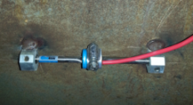
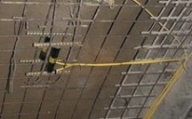
6. Strain gauge in Steel section
It measures strain in ribs and
struts.
7. Strain gauge in shotcrete
Used to measure strain
in shotcrete to estimate
the stress on the section.

Slide 21
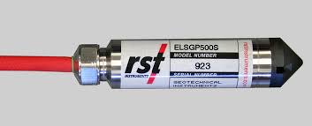
8. Piezometer
Used to measure pore water pressure around tunnel.
Pore water pressure gives seepage pressure and hydraulic pressure around the tunnel rock mass for checking of design parameter.

Slide 22
Conclusions
Instrumentation is important to synchronise design & construction process with actual observation made during tunnelling.
Instrumentation is indispensable for site investigation, design verification and safety of the structure.
Instrumentation in tunnels can be implemented in three stages:-
pre-construction stage,
construction stage and
post-construction / operation stage.
Extensive instrumentation has helped in economising the design of the support system in a continuously varying rock mass/soil property.

Slide 23
THANK YOU !

